Slide 1




Artificial Intelligence : Transforming the future
Date : August 1, 2023
Presenter : Bapreet Kaur
Program: Computer Programming and Analysis

Slide 2
Today, we will explore the exciting world of artificial intelligence and its potential to revolutionize industries, reshape economies, and shape the future of humanity.

Slide 3
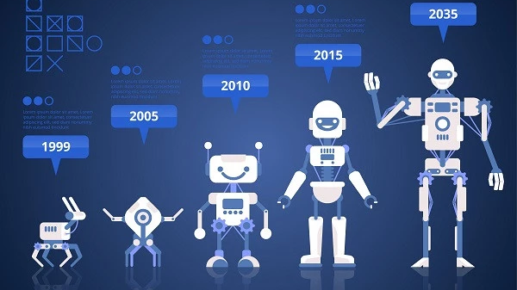
"Artificial intelligence will reach human-level intelligence by 2029." - Ray Kurzweil, Futurist and Inventor

Slide 4
Agenda
What is Artificial Intelligence (AI)?
AI in Everyday Life
AI's Impact on Industries
Ethical Considerations and Challenges
The Future Possibilities of AI
Conclusion

Slide 5
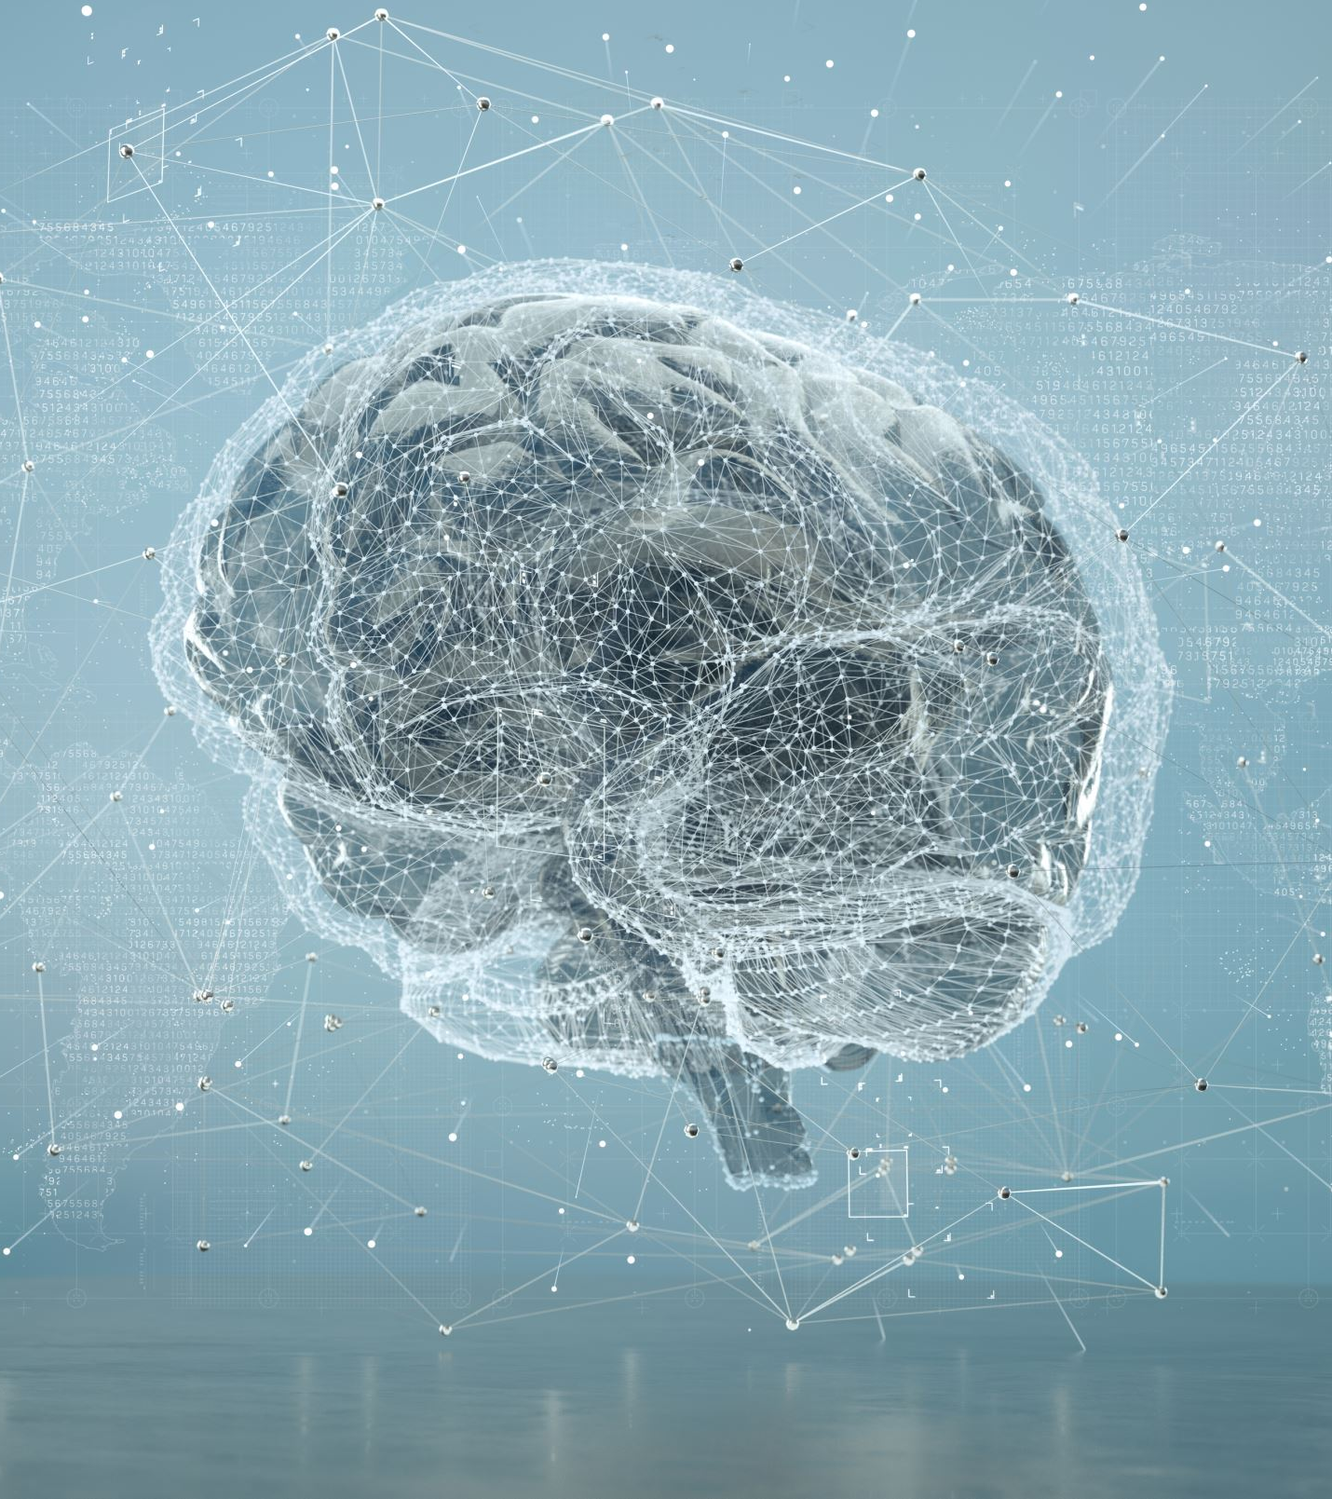
What is artificial intelligence (Ai)?
AI is the simulation of human intelligence in machines that are programmed to think and learn like humans. It encompasses various technologies like machine learning, natural language processing, and computer vision.

Slide 6
AI IN EVERYDAY LIFE
Virtual Assistants: Voice-activated AI that helps users with tasks and answers questions.
Recommendation Systems: AI algorithms suggesting products, movies, or content based on user preferences.
Smart Home Devices: AI-powered devices that control lighting, temperature, and security in homes.
Social Media: AI analyzing user behavior for targeted advertising and content curation.

Slide 7
AI’s impact on industries
Healthcare: AI assisting in diagnosis, drug discovery, and personalized treatment plans.
Finance: AI-powered algorithms for fraud detection, investment strategies, and risk assessment.
Transportation: AI driving autonomous vehicles and optimizing traffic flow.
Manufacturing: AI streamlining production processes and predictive maintenance.

Slide 8
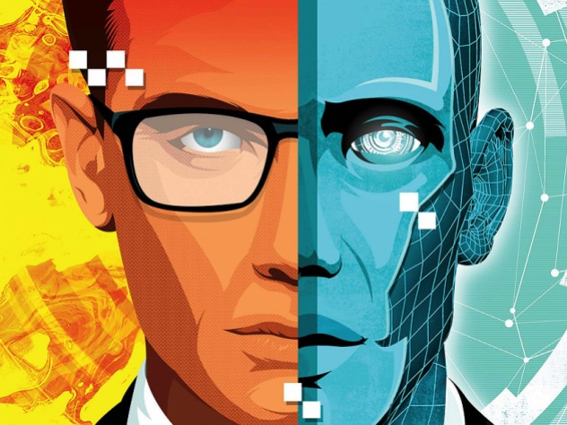
Ethical Considerations and Challenges
Bias and Fairness: Ensuring AI systems are free from discrimination and represent diverse perspectives.
Privacy: Protecting user data and ensuring responsible data usage.
Job Displacement: Addressing potential job losses due to automation.
Autonomous Weapons: Controlling the use of AI in military applications.

Slide 9
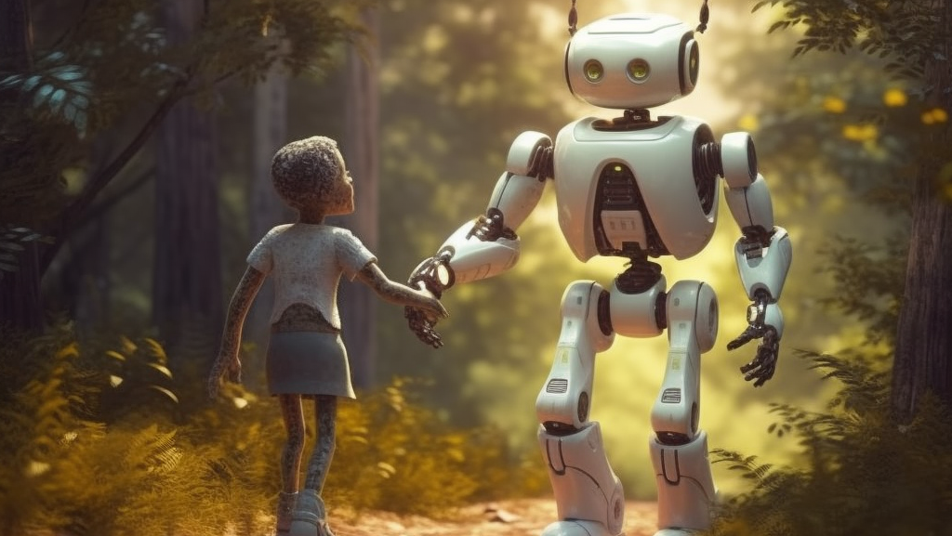
The Future Possibilities of AI
Artificial General Intelligence (AGI): AI with human-level intelligence and adaptability.
Healthcare Advancements: AI contributing to disease prevention and personalized medicine.
Space Exploration: AI aiding in space missions and interstellar exploration.
Climate Change Solutions: AI helping to find sustainable solutions for environmental challenges.

Slide 10
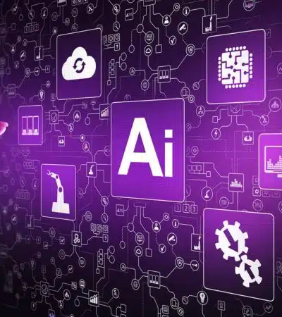
Conclusion
Artificial Intelligence holds immense potential to transform our lives and shape the future in ways we couldn't have imagined. As we embrace AI, it is vital to address ethical concerns and leverage its power responsibly.

Slide 11


